Slide 1

Electronic services delivery
the model of the Crossroads Bank

Slide 2
Structure of the presentation
social sector: stakeholders, expectations
model of the Crossroads Bank: principles, service integrator
application in the social sector: Crossroads Bank for Social Security (CBSS)
challenges
Europe
some projects
conclusion: benefits achieved, critical success factors

Slide 3
1. Social sector

Slide 4






Stakeholders
v
> 11.5 million citizens
> 1 million self-employed
3 000 actors in charge of
social protection
> 225 000 employers

Slide 5
Expectations > citizens/employers
effective social protection
integrated services
  adjusted to their concrete situation, personalised where possible
  offered at events that occur during their life cycle
    birth
    school
    work
    removal
    illness
    retirement
    death
    creation of a company
    …
  across government levels, public services and private bodies

Slide 6
Expectations > citizens/employers
customer centricity
tailored to the own processes
with minimal costs and administrative formalities
if possible automatically provided
with active involvement of the user (self-service - self-management - follow-up)
high-performing and user-friendly
reliable, safe and permanently available
through the channels of their choice (direct contact, phone, electronic, ...)
with the respect of privacy

Slide 7
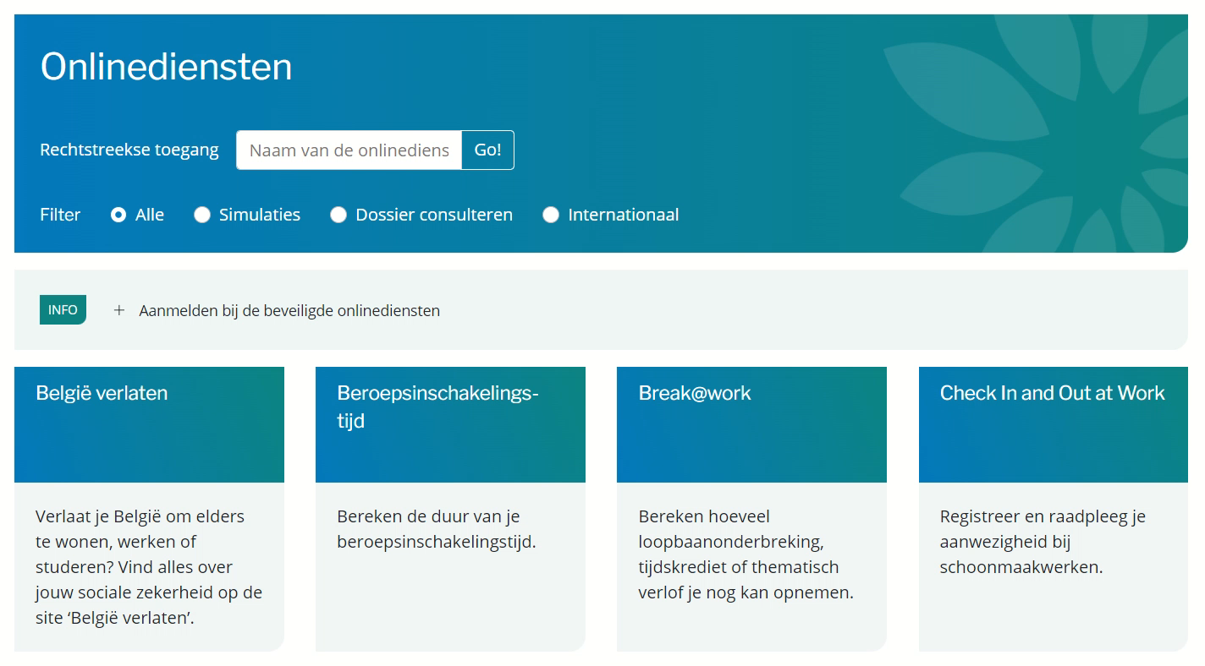







Customer centricity

Slide 8
Expectations > authorities
citizens and companies are satisfied because they receive integrated services that meet their expectations at minimal cost and burden
maximising the effectiveness of social policy
cost control for all stakeholders
optimising the efficiency of the functioning of public services and private bodies with missions of general interest
proactive use of information for
  automatic granting of rights
  pre-filling when collecting information
  targeted communication of information to the persons concerned
solid policy support
promoting social inclusion
preventing and combating fraud

Slide 9
2. Model of the Crossroads Bank

Slide 10
model of the Crossroads Bank
organising process optimisation and well-secured and efficient electronic data exchange between many actors
with respect for their autonomy and the tasks assigned to them
without a massive central storage of personal data
for the purpose of providing integrated electronic services that meet the expectations of users (citizens, businesses, professionals, etc.)
coordinated, stimulated and organised by a service integrator with a crossroads function
based on common principles of
  information modelling
  unique collection and re-use of information
  information management
  electronic exchange of information
  information security and privacy protection

Slide 11
Crossroads Bank model / common principles
information modelling
  in a way that is as close as possible to reality
  so that it can be used in a multifunctional way
  which considers as far as possible the expected needs for use of the information
  can be flexibly extended and adapted if reality or usage needs change (reduce or increase)
one-time collection of factual information from citizens and companies in coordination between all actors
  information is only collected for well-defined purposes and in a proportional way to these purposes
  all information is collected once, as close as possible to the authentic source
  through a channel chosen by the citizens and companies
  preferably by electronic means and with uniform basic services
  with the possibility of quality control by the person from whom the information is collected prior to the transfer of information

Slide 12
Crossroads Bank model / common principles
information management
  distribution of tasks between the actors in the social sector regarding collection, validation, management, information storage in authentic sources and data exchange initiative (pull and push)
  information can be flexibly assembled according to ever changing needs
  obligation to report suspected errors in the information to the actor in charge of its validation
  the actor that has to validate information, has to examine the reported probable improprieties, to correct them when necessary and to communicate the correct information to every known interested bodies
  information will be retained and managed as long as there exists a business need, a legislative or policy requirement, or, preferably anonimized or encoded, when it has historical or archival importance

Slide 13
Crossroads Bank model / common principles
electronic exchange of information
  once collected and validated, information is stored, managed and exchanged electronically to avoid transcribing and re-entering it manually
  information is exchanged only with the consent of the data subject or when required by the needs of the organisation, policy or regulation
  electronic information exchange can be initiated by
    the body holding the information or
    the body that needs the information or
    the service integrator
  electronic information exchange takes place on the basis of a functional and technical interoperabilty framework that evolves gradually but permanently according to open market standards and is independent of the information exchange method used
  proactive use of information for
    automatic granting of rights
    pre-filling when collecting information
    targeted communication of information to the persons concerned

Slide 14
Crossroads Bank model / common principles
information protection
  the security, integrity and confidentiality of processed information is ensured by an integrated set of structural, organisational, ICT technical, physical, personal and other security measures
  personal data are only used for purposes compatible with the purposes of the information collection
  personal data are only accessible to authorised users according to the needs of the organisation, the policy or regulation enforcement
  excluding the cases where access is provided by law, the access authorisation to personal data is granted by the Information Security Committee

Slide 15
Crossroads Bank model / common principles
security & privacy by design
  any communication of personal data to third parties requires an authorisation by the Information Security Committee
  the authorisations for the communication of personal data are available to the public
  every concrete electronic exchange of personal data is preventively checked for compliance with the authorisations in force by an authority other than the one making the information available or needing the information, in this case the service integrator with crossroads function
  every electronic exchange of personal data is logged, to be able to trace possible abuse afterwards
  whenever information is used for a decision, the information used is communicated together with the decision
  every person has the right to access his or her own personal data and to correct them if they are incorrect
  an information security department is established at each body participating in the electronic data flow, which has advisory, stimulating, documenting and controlling tasks
  set of structural, organisational, legal and technical measures, described in policies based on the ISO 27xxx standard

Slide 16
Crossroads Bank model / service integrator
service integrator with crossroads function and managed by the representatives of the actors of the sector concerned in order to
  gain their confidence
  ensure a customer-oriented functioning
tasks of the service integrator
  define a vision for integrated e-services in the sector concerned
  define and promote the vision and common basic principles in the sector concerned
  coordinate the process optimisation
  program and project management
  define, implement and manage the collaboration platform
    technical: architecture and standards for a secure information exchange
    semantic: concept harmonisation and coordination of regulation changes
    business logic and orchestration
    promotion of service oriented applications

Slide 17
Crossroads Bank model / service integrator
tasks of the service integrator
  management of a reference directory (= basis for the organisation of the electronic information exchange between the actors of the sector concerned)
    content
      about which people, what kind of information is available where in relation to which periods
      which actors are allowed to obtain which information about which people in which circumstances
      which actors want to automatically obtain which information about which people in which circumstances
    functions
      preventive access control
      routing of information
      automatic notification of modified data
  change management, training and coaching
  acting as a trusted third party for data encryption and anonymisation

Slide 18
model of the Crossroads Bank
effectiveness of policies
  information systems for
    policy support
    research
    policy evaluation
  strategic use of information systems
    to avoid non-take up (automatic granting)
    for social inclusion
    for fraud prevention and control
    for continuity in the allocation of rights
    …
efficiency of policy implementation
  operational excellence
  data management and protection
    collected and validated once
    correct and timely available
    reusable and shared
  processes
    event driven
    process chain
    distribution of tasks between actors in accordance with competence
  architecture
    Service Oriented Architecture
    modularity and encapsulation
    synergies through cloud and container technology

Slide 19
3. Application in the social sector

Slide 20
Crossroads Bank for Social Security
created at the FPS Social Security
  law of 15 January 1990
joint management
  law of 25 April 1963 on the management of public social security and social welfare institutions
  management committee, including representatives of employees, employers and self-employed persons
certain autonomy
  royal decree of 3 April 1997 containing measures to guarantee the accountability of public social security institutions
  management agreement method
    agreement between the government and the CBSS
    includes specific rules and conditions under which the CBSS fulfils its missions
    the CBSS is a public social security institution

Slide 21
Crossroads Bank for Social Security
goal
  act as the driving force and coordinator of e-government in the social sector
  bring the actors in the field together and help improving the quality, effectiveness, efficiency and performance of the social sector
  continue to promote a revision of the processes and relationships between the 3 000 bodies active in the social sector (federal, regional, community and local bodies) and between these bodies, civil society organisations, citizens and companies
innovation
  ability to anticipate major challenges and provide innovative responses to them
  pioneer of legislation on new technologies and implementation of new projects using these technologies
  full service oriented platform (SOA)
  G-cloud

Slide 22
Crossroads Bank for Social Security / results
  a network between 3 000 social sector actors with basic services
  > 1.8 billion messages exchanged between the actors in the sector in 2023
  unique identification of the citizens
  unique identification of the companies
  rationalization, unique collection and re-use of information
  automatic granting of additional rights
  220 structured messages and about 120 web services in production after process optimisation and authorisations from the Information Security Committee
  multifunctional declarations from employers to the whole social security sector from application to application including wage and working time data
  abolition of almost all direct and indirect information exchanges on paper
  common data centre for the PSSI, SOA environment, shared and integrated services, Cloud-environment
  more effective fight against fraud
  annual savings of € 1 billion in administrative burden for the social sector

Slide 23
Network with basic services
Internet
technical network
R
FedMAN
Users
R
Isabel
FW
R
…
R
Backbone
FW
FW
FW
FW
FW
R
R
R
R
R
NEO
CBSS
NOSS
R
R
NIC
…

Slide 24




Network with basic services
utility companies
functional network
NOSS
NISSE
FPS
ASI
SIGeDIS
PPS SI
Regions and Communities
FPS ELSD
cities
Municipalities
PCWC
FEDRIS
NEO
NOAH
CIN
NIHDI
FPS SS

Slide 25
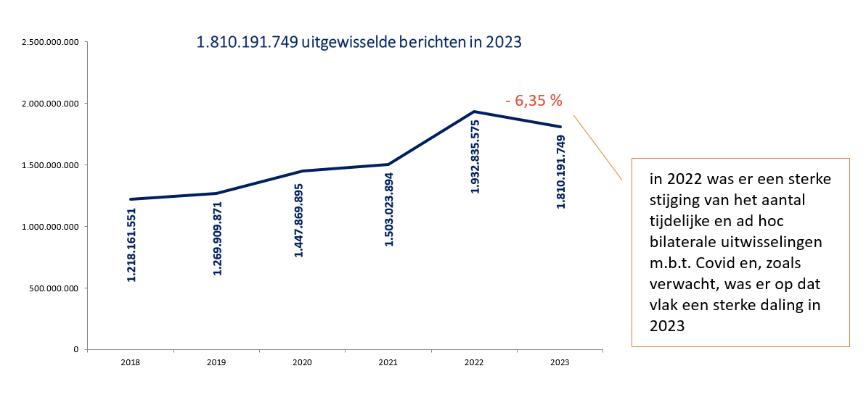

Slide 26


Process simplification
between 3 000 actors involved in social protection
  between 3 000 actors involved in social protection
  on the one side and 225 000 employers on the other side
→ limited to 3 moments and as far as possible from application
to application
the immediate declaration of employment
the quarterly declaration of wage and working time date
the occurrence of a social risk
v
800 paper forms
220 electronic processes
v
80 paper forms
30 electronic processes

Slide 27
Process simplification
electronic messages have been reduced on
average to 1/3 of the number of sections on paper forms
Planning bureau: structural reduction of company charges
due to administrative formalities in the social sector
by > €1 billion per year
v
v
1 milliard €

Slide 28
Availability and treatment
availability of the network services (norm: 99 %)
response time (norms: 99 % - 99.5 %)
99.99 %
99.98 %
99.97 %
information system of the CBSS | services of National Register | services of the NOSS
99.59%
99.92%
99.85%
maximum response time of one second | maximum response time of two seconds | services processed in batch within 4 calendar days

Slide 29
Reference directory
26.1 million
14.57 sectors
390 million
several persons registered in the reference directory | number of sectors in which each person is known (=average) | active records in the reference directory

Slide 30
Crossroads Bank for Social Security
Law of 15 January 1990
< 90 employees
19 million € annual budget
network with
3 000 actors in the social sector
management
agreement
Management Committee
General
Coordination committee
ISC - Information Security Committee
> 1.8 billion
messages exchanged in 2023
190 BPR and 220
structured
messages
120 web services
99.9%
availability
of the services
social security portal
29 applications
for the citizens
> 50 applications for the compagnies
> 25 national and international awards

Slide 31
Frank Robben
general manager
Thibaut Duvillier
assistant general manager
Client, Program, Project management
Pim Petereyns
Application Development
Danny Devos
Innovation and Policy Support
Peter Maes
Audit & Information Security
Kurt Maekelberghe
Resources management
Laure Morelli
Project leaders
Lead architect
Jurists
Human resources
Technical interoperability
Application engineers
Communication
Budget & finance
Identification
Application developers
Data-analist
Facility management
Service management
System
Risk management & internal control
Middleware/ESB
Management Information System
Translators
core
value- added
I&S
supporting

Slide 32
4. Challenges

Slide 33
Challenges
thorough process optimisation and digitalisation within social security over the past decades
new challenges due to social evolutions
  concepts are continuously changing
  ‘new way of working’ - mixed careers/platform economies/...
  technological evolutions : smartphones, ArtificiaI Intelligence (AI),...
  increasing risk of digital gap
  increasing information security risks
  reallocation of competences not always transparent for citizens
  …
redesigning digital social security according to the new social needs
  actualisation of digital systems, structures and services
  make social security future-proof
eGov3.0 or eGov Next built around 8 pillars

Slide 34
eGov3 - 8 pillars
large unique data model, transparency and autonomy
simplifying regulation and processes
user centric
across the policy levels
share in “real time” and take “first time righ” decisions
digital inclusion
automatic granting of rights
future-proof business architecture

Slide 35
Challenges
state reforms and decentralisation of policy decisions
  integrated service delivery with minimal administrative burden
  should not increase overall implementation costs
suggestions
  avoid overlapping or uncoordinated decision-making → transparency
  well-considered organisation of implementation and its management
    agreements between the different policy levels on data needs
    managing the number of implementing bodies
    service integration
    common legislation on information management and information security
    cooperation agreements
Notes:
minimale administratieve lasten voor de burgers en de ondernemingen
suggesties
vermijden van overlappende of ongecoördineerde besluitvorming
transparantie tussen de onderscheiden beleidsniveaus over respectievelijk beleid en regelgeving
weloverwogen uitvoeringsorganisatie en het beheer ervan
beheersen van het aantal uitvoeringsinstellingen
→streven naar intergouvernementele organisaties met waarborg van een geïntegreerde en loyale uitvoering van het respectievelijke beleid
→vertegenwoordigers van onderscheiden overheidsniveaus in beheersorganen van de intergouvernementele organisaties
→gemeenschappelijke financiering volgens vastgelegde parameters
dienstenintegratie:
→ binnen een thematische sector, verticale overheidsniveau-overschrijdende informatiebeheerprocessen

Slide 36
Challenges
unique data model and central data layer
  the CBSS contributes to an uniform concept of income (available resources)
    income from employment (employee, civil servant, self-employed)
    social insurance
    welfare
    heritage
  aligning operational concept with statistical concept
  as actual as possible
future-proof enterprise architecture for social security
  transition to API economy
  transition to Event Driven Architecture (EDA)
Notes:
sociale verzekeringen
inkomensvervangend (ziekte en invaliditeit, arbeidsongeval, beroepsziekte, werkloosheid, ouderdom, overlijden)
kostendekkend (kinderlast, geneeskundige verzorging)
bijstand
gewaarborgde gezinsbijslag
IGO
tegemoetkoming aan gehandicapten
leefloon

Slide 37








API Economy - CBSS & Social Security API Gateway Platform
PROVIDERS
CONSUMERS
API in the bodies
API of the body for BREAK OUT
API for the PISS
(Via CBSS)
API of the CBSS for the SSPI
API for the public bodies (no CBSS)
API for third party (relation, authorisation)
API for third party (consent, authorisation)
eBOX
Wallet …
PORTAL
AUTHORISATION SERVICE & BCSS
(reference directory - authorisation - logging)
SECURITY & COMPLIANCE

Slide 38
Event-Driven Architecture (EDA)
Event-Driven Architecture (EDA) is a strong alternative to
Managed File Transfer and file driven exchanges as a legacy of mainframe technology
Real-Time Updates: Social security systems often involve the processing of various events, such as changes in employment status, updates in personal information, or eligibility criteria.
EDA allows for real-time updates and notifications, ensuring that relevant parties are informed promptly about any changes or events.
Event-Driven Architecture (EDA) is an architectural pattern that emphasizes the production, detection, consumption, and reaction to events. In this context, an event is a change in state or a significant occurrence within a system.
EDA is widely used in various domains, including software systems, microservices, and distributed systems

Slide 39
5. Europe

Slide 40
European framework
Digital (Identity) Wallet
European Health Insurance Card
Single Digital Gateway
Electronic Exchange of Social Security Information (EESSI) / Reference Implementation for a National Applications (RINA)
Network & Information Security v2 (NIS2)

Slide 41
Digital (Identity) Wallet
every Member State should offer a ‘digital identity wallet’ free of charge
the tool par excellence for identifying oneself in Europe and signing up to online public services
electronic Identification And Trust Services 2.0 (eIDAS2.0) → large-scale cross-border management with an European architectural reference framework
the CBSS is taking part, together with the FPS BOSA, in the development of the Belgian digital wallet with the aim of
  the authentication of the (digital) identity based on the authentic source National Register
  the option of loading and storing digital proofs for offline verification
  reading the information by means of a signed QR code, which is also available in Pdf format
  the MyGov.be application

Slide 42
Digital (Identity) Wallet - first use cases
social security
  dematerialisation isi+ card
  social status → alternative for MyBEnefits
  parking pass for people with disabilities
health level
  existing Covid certificates (test/recovery/vaccination)
European level
  European Health Insurance Card (EHIC)
  European Disability Card (EDC)
world level
  vaccination proofs (World Health Organization (WHO))
Notes:
carte isi+
attribuée aux personnes ne possédant pas de titre d’identité belge
mais qui bénéficient néanmoins de la sécurité sociale belge
(enfant, travailleur frontalier)
MyBEnefits
permet à un citoyen d’attester de ses statuts sociaux

Slide 43
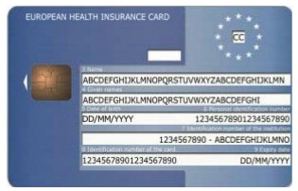
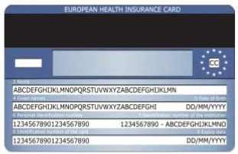
European Health Insurance Card (EHIC)
250 million paper EHICs per year → cost > 1 billion euros
many restrictions
  insurance rates not guaranteed at time of care delivery
  if forgotten → no downloading of digital EHIC
implementation of the digital EHIC is a priority during the Belgian presidency
the CBSS has formulated a proposal to adapt the regulations in order to also make a digital version of the EHIC possible
Notes:
vele beperkingen
burgers zijn er niet zeker van dat ze gezondheidszorg kunnen krijgen tegen Belgische verzekeringstarieven in andere EU-lidstaten
als ze de EZVK niet kunnen laten zien op het moment van zorgverlening
burgers die vergeten zijn een papieren EZVK aan te vragen voor vertrek naar een andere EU-lidstaat kunnen geen elektronische EZVK downloaden

Slide 44
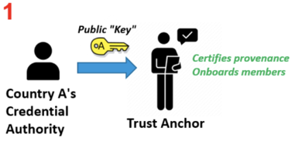
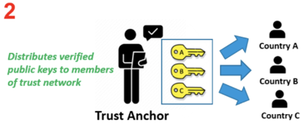
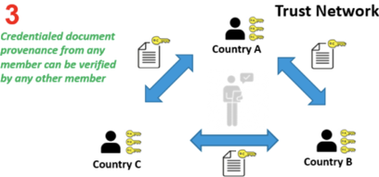
European Health Insurance Card
technical pathway - cross-border verification of ‘digital credentials’ authenticity
  adoption by the World Health Organisation (WHO) of the EU Digital COVID Certificate Gateway since the end of 2023
  onboarding on WHO's Global Digital Health Certification Network (GDHCN)

Slide 45
Single Digital Gateway (SDG)
the SDG creates a digital gateway in accordance with European regulations
where all citizens and companies of an EU country can find information, procedures and online services to support and solve their problems within another EU country
goal
  reducing the administrative burden of citizens and companies
  improving the working of the internal market
  eliminating discrimination
putting into production the processes for which the CBSS was designated as driving force
  request of an EHIC
  request of a (pre)retirement allowance from mandatory schemes
  request for information about mandatory pension schemes
  notification of changes in the personal or occupational situation of the person who receives social security allowances

Slide 46


Slide 47
Electronic Exchange of Social Security Information (EESSI)
the EU and EFTA (European Free Trade Association) citizens can free move, live and work in other EEA/EFTA countries
the social security systems should reflect this mobility and ensure that citizens have full access to social security in a cross-border context
EESSI = secure European electronic network interconnecting social security institutions
the CBSS is responsible for the Access Point (unique gateway for BE) and the National Gateway (bus to the back office applications)

Slide 48
Reference Implementation for a National Applications (RINA)
RINA = European online service for the electronic exchange of social security files between the competent institutions of the European Union countries
results from the EESSI project
manages all administrative processes related to the exchange of social security data at European level
tools for managing files and optimising internal workflows
RINA is accessible to the social service providers

Slide 49
Network & Information Security (NIS2)
European cybersecurity directive
set of measures for a high common level of cybersecurity across the European Union
  applicable to critical sectors
    public companies
    health sector
    other critical sectors such as public administrations, financial markets, transport, ...
aiming for risk management in information processing
applicable by October 2024 at the latest

Slide 50
6. Projects

Slide 51
Projects of the BCSS
focus is on projects regarding administrative simplification and the principle of collecting data once (only once), which is expressed in a good Return On Investment (ROI) and the search for efficiency
  process optimisation
  reuse of existing flows/messages
  thinking about projects in a general way
matrix only once : data exchanges in the social sector in one view
  status of the only once programme
  data exchanges from and into the social security network
  indication of reuse of relevant authentic sources

Slide 52
Matrix only once
4 tables
  the categories of personal data exchanged between social security institutions
  the categories of personal data provided by government bodies active outside the social sector to social security institutions
  the categories of personal data provided by social security institutions to government bodies active outside the social sector
  the categories of personal data provided by social security institutions to various government bodies of the Communities and Regions (specifying the last 4 columns from the previous table)
  → link to the tables of the matrix on the CBSS website

Slide 53
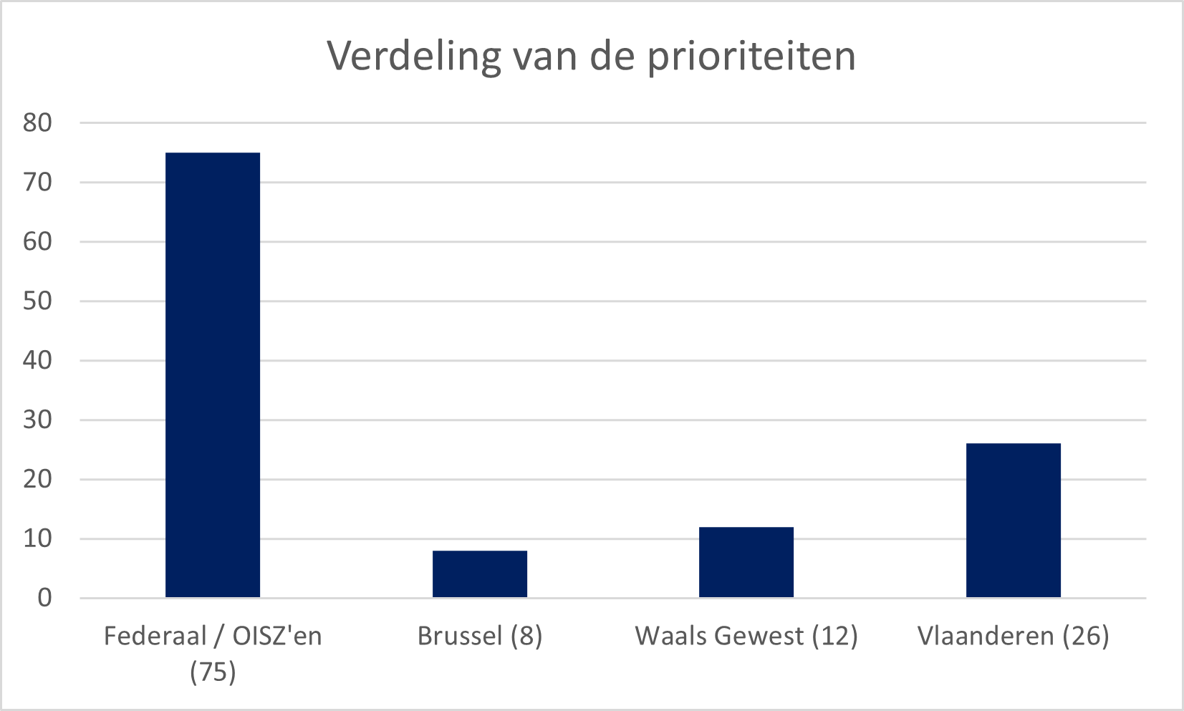
Priorities 2024
list of the priorities 2024
  consolidated portfolio of > 400 applications and change request available on the page dedicated to the General Coordination Committee on the website
  https://www.ksz-bcss.fgov.be/nl/over-de-ksz/beheer/algemeen-coordinatiecomite#prioriteiten

Slide 54
A few projects in which the CBSS is participating
  additional rights - harmonised social status (HSS) & MyBEnefits
  eBox citizen
  regionalisation
  PSWC
  fighting against fraud
  isi+ card
  G-Cloud
  Datawarehouse labour market and social protection
  services for employers
  (Dimona – DmfA – GSR)
  services for citizens
  services for third parties
  social security portal

Slide 55
Additional rights
‘social status’ for about 2 million citizens in Belgium
  limited income
  disability, physical or mental impairment
  child with special needs
  …
citizens with social status receive ‘additional rights’
  social tariff for gas, electricity, water, telecoms
  public transport (SNCB, De Lijn, TEC, etc.)
  housing
  tax reduction, free collection of household waste
  reduction for socio-cultural activities, sports
  …

Slide 56
Additional rights
observation of non-take up
  non-transparency: people have limited or no knowledge of their rights
  Matthew effect: rights do not reach the intended (vulnerable) target group
  threshold: the application and granting procedure for social rights is often complicated and time-consuming
  ineffectiveness: social measures do not achieve their goal
  status quo of poverty ratio instead of social inclusion: the population of poor people does not decrease proportionally

Slide 57
Harmonised social status (HSS)
context
  the social status are often complex and not always understood by the various parties involved
  regionalisation of the social status
  regulations on granting ‘additional rights’ are also complex (benefits/conditions/referral periods)
  no clear concepts
  a large number of data exchanges already exist (preferential rate, exemption from duties or taxes, etc.)
  regular new requests to data providers result in ad hoc developments

Slide 58
HSS - social status / examples

Slide 59
HSS - principles
factual information available in one or more authentic source(s) is made available to actors who, on that basis, automatically grant rights to citizens without any request being made
standardised services in order to answer information requests as much as possible and avoid/limit multiple developments, both for the data providers (authentic sources) and the bodies granting benefits
reduction in the number of status used and their complexity, a reduction of data exchanges
reduction of administrative formalities and paper certificates requested to this vulnerable population group

Slide 60
HSS - goals
for the socially insured
  allowing citizens to fully benefit from the additional rights to which they are entitled
  minimise administrative formalities & take into account the reality in the field
for the bodies/actors granting the advantage
  easy access to all necessary information for granting (social status, domicile address, etc.)
  avoid possible abuses
continue to improve automatic granting of rights

Slide 61
HSS - 3 approaches
the CBSS and the authentic sources are working on making 3 additional methods available
batch consultation of the so-named ‘buffer’ database
online consultation of the authentic sources by the granting bodies
consultation of the social status using the app MyBEnefits

Slide 62
HSS - approach 1
batch consultation of the database HSS in the buffer database
  is fed quarterly by the 11 authentic sources
  possibility of the automatic granting of additional rights to a category of persons known in advance at the granting body
    e.g. all residents of a municipality, all households connected to gas
  possibility of processing large volumes
  possibility of checking whether a person meets a set of criteria defined in the deliberations of the ISC (e.g. place of residence, status on a certain date, etc.)
  some examples
    social tariff for gas/electricity in Belgium
    social tariff for water in Flanders
    traffic tax exemption in Brussels Region
    municipalities and provinces (e.g. reduced rate for afterschool childcare, reduced charge for household waste collection, reduced tax rate)

Slide 63
Buffer database - 11 authentic sources
federal
  PPS Social Integration (PPS SI) and PCSWs (e.g. living wage ((e)LW)
  DG Persons with Disabilities (DGPH) (e.g. recognised disability, income replacement allowance (ARR))
  sickness funds (e.g. right to increased insurance allowance)
  Federal Pension Service (e.g. guaranteed income for elderly persons (GRAPA))
Flanders
  Flemish Social Protection (VSB) (e.g. allowance for assistance to the elderly (APA))
  Agentschap Opgroeien ( (e.g. children with specific support needs (P1-4))
Wallonia
  Agence wallonne pour une Vie de Qualité (AViQ) (e.g. recognised disability of children)
  Organismes Assureurs Wallons (OAW) (e.g. (e.g. reduction of self-reliance)
Brussels
  IrisCare (e.g. allowance for assistance to the elderly)
German-speaking Community
  Dienststelle für Selbstbestimmtes Leben (DSL) (e.g. recognised disability of children)
  Ministerium der Deutschsprachigen Gemeinschaft (MDG) (e.g. allowance for assistance to the elderly (APA))

Slide 64
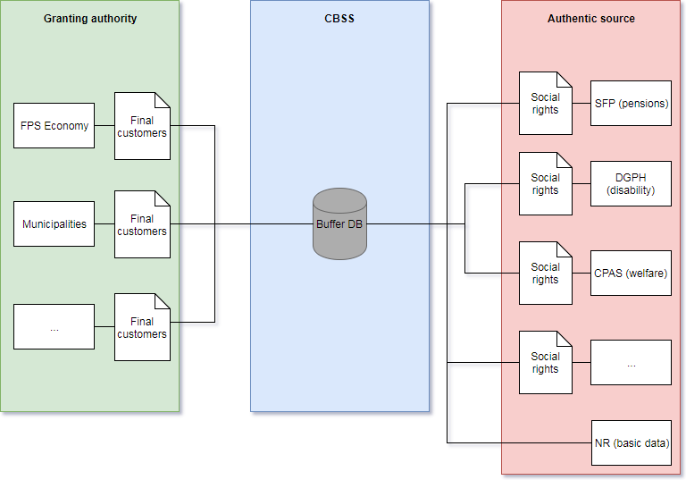
Buffer database - feeding / use

Slide 65
Buffer database - advantages
for data users
  all the information is available on a coordinated and validated way
  possibility for the CBSS to apply decision rules according to the concrete needs of each user (‘’guarantee of the proportionality principle‘’)
for the managers of authentic sources
  to avoid ad hoc developments for each data request
  to avoid making data available according to the needs of each user
for the system
  an impulse to standardise the factual data to be taken into account when determining additional rights and the time or period over which they should be available (‘Lego block philosophy’)

Slide 66
Buffer database - legal aspects
general deliberation No 16/008 of 2 February 2016 on the creation of the buffer database at the Crossroads Bank for Social Security for the automatic granting of additional rights
this project is strongly linked to the harmonisation of the status used for the granting of additional rights ; this essential aspect of the project will be realised, in particular, in consultation with the social partners
necessary simplification of legislations in order to comply with the Lego block philosophy

Slide 67
Buffer database - simplification of the regulation
e.g. Don’t
e.g. Do
A bonus is granted to the reference person of the household registered in the municipality of which at least 1 or more household members are on the 1st January of the relevant financial year entitled to
the preferential reimbursement for health care
the guaranteed income for elderly persons
the allowance for disabled persons
increased child benefit (regulation salaried or self-employed workers)
A bonus is granted to the reference person
of the household registered in the municipality of which at least 1 or more household members are on the 1st January of the relevant financial year entitled to the
enhanced allowance of the health care insurance (referred to in Article 37, §19, of the Act on compulsory insurance for medical care and benefits, coordinated on 14 July 1994)

Slide 68
Lego block philosophy
Authentic source (NR & CBSS)
Date of birth
Place of residence
Household composition
Social status
FPS or PISS
GRAPA - IGO
Additional right
Granting bodies
RG - GI
ATP - THVD
…
Reduction of provincial tax
Province of East Flanders
PSWC
RIS - LL
AF - EQ - LL
DGPH
P1-4
…
Income
Sickness funds
BIM - BVT

Slide 69
Lego block philosophy
Authentic source (NR & CBSS)
Date of birth
Place of residence
Household composition
Social status
FPS or PISS
GRAPA - IGO
Additional right
Granting bodies
RG - GI
ATP - THVD
…
Social tariff gas & electricity
FPS Economy & utility companies
PSWC
RIS - LL
AF - EQ - LL
DGPH
P1-4
…
Income
Sickness funds
BIM - BVT

Slide 70
Lego block philosophy
Authentic source (NR & CBSS)
Date of birth
Place of residence
Household composition
Social status
FPS or PISS
GRAPA - IGO
Granting bodies
RG - GI
Additional right
ATP - THVD
…
Reduction on household waste processing tax
Municipality of Charleroi
PSWC
RIS - LL
AF - EQ - LL
DGPH
P1-4
…
Income
Sickness funds
BIM - BVT

Slide 71
HSS - approach 2
online consultation of the authentic sources by the granting bodies
  online and interactive for specific files
  possibility of checking whether potential beneficiary meets criteria on a given date
  possibility of granting right to any potential beneficiary not known in advance
    public transport user
  possibility of checking whether a person meets all the criteria defined in the deliberation of the ISC (e.g. place of residence, status at a certain date, etc.)
  a few examples
    additional family benefits in the German-speaking Community and the Walloon Region
    additional service vouchers (WSE)
    enhanced allowance card and free companion card (SNCB)
    Brussel'Air premium (Brussels Mobility)

Slide 72
HSS - approach 3
since February 2019 MyBEnefits.fgov
  additional tool via a mobile app & web application
  through which the citizen can consult and prove his social status on the date of the day in order to apply his rights to the various granting bodies
  through which the professional user, mainly the granting bodies that are not traditional partners of the CBSS, can check the data
    actors who typically do not cooperate directly with the CBSS (e.g. : sports, childcare, museums, recreation centres, amusement parks, etc.)
    actors who do not (yet) have an automatic data flow (e.g. : pro deo legal aid, municipal tax rebate, ...)
  through which citizens and professionals can consult/report benefits in the culture, sports and leisure sector

Slide 73
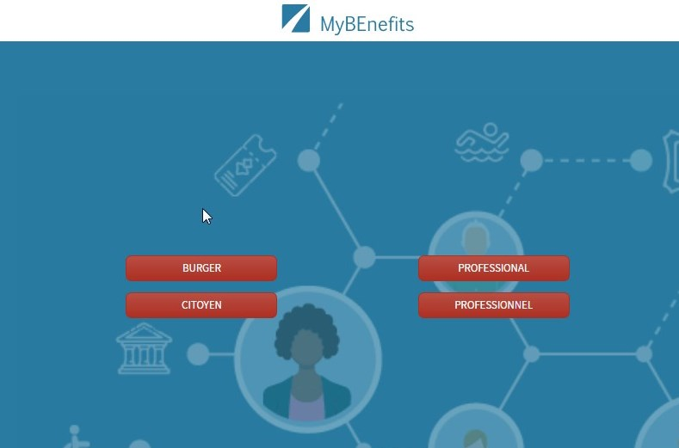



MyBEnefits
Sickness funds
PSWC
FPS
DGPH
…
mobile app available for Android (Google Play) and for Apple devices (App Store)
web application www.mybenefits.fgov.be

Slide 74


Secure login
citizen : identification required
  consult status
  privacy-sensitive information: sufficiently high level of security
    e-ID
    ITSME
    Time-based One-Time Password
    Token
  create QR code / if necessary print it (only via website)
professional : no identification required
  read QR code / unique code provided by the citizen
  minimum information: status, postal code, control number NR number

Slide 75
MyBEnefits - 3 functionalities
  verification of social status
- the citizen, after identifying himself, consults his social status in real time and generates a code as electronic proof that he can show in order to obtain his social rights and benefits more easily
- the professional user (the granting body) can, without identification/authentication/technical integration, read and verify the code generated and shown by a citizen for the purpose of granting a benefit
  request social benefits
  - more than 200 benefits for people with social status mapped out and displayed as dynamic lists
  - users can filter benefits intuitively and refine their search based on three criteria: geographical area, user profile and category of benefits searched
  increase the visibility and use of social benefits
  - every citizen or professional can communicate information on social rights and benefits through the ‘communicate a benefit’ function
  - by ticking off and filling in a few boxes accurately, information can be shared and the list of new benefits can be completed
  - the focus is on the following three areas: leisure, sport and culture

Slide 76
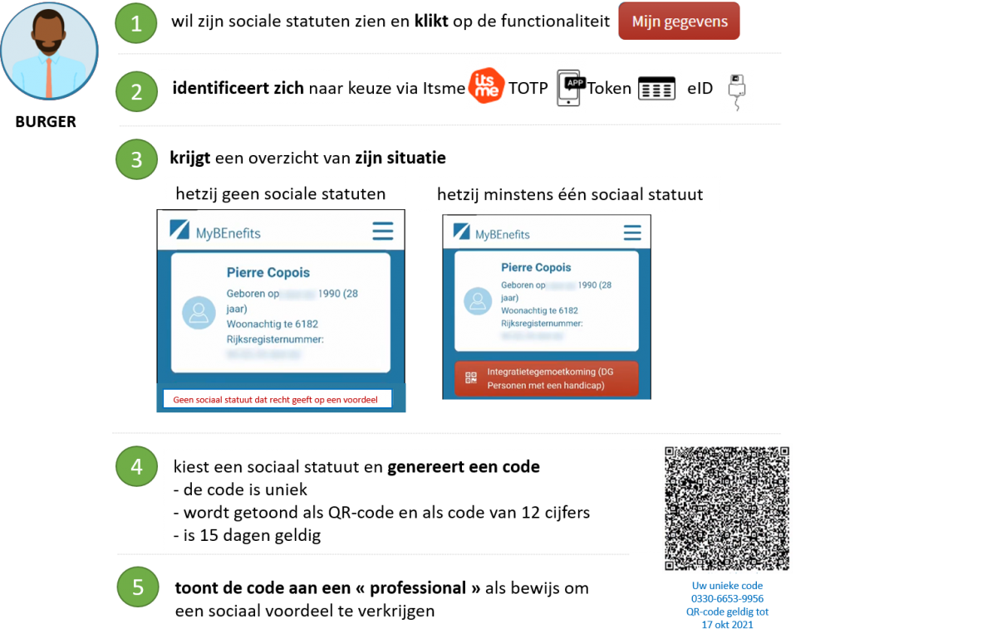
Social status - consultation & code creation

Slide 77
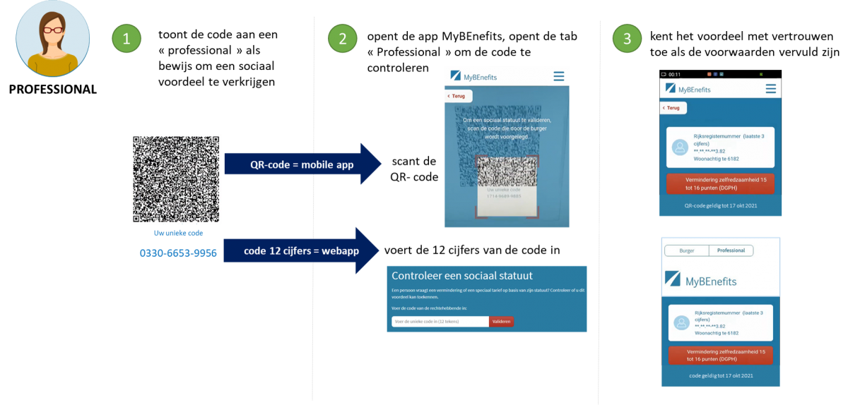
Professional - verification of the social status

Slide 78
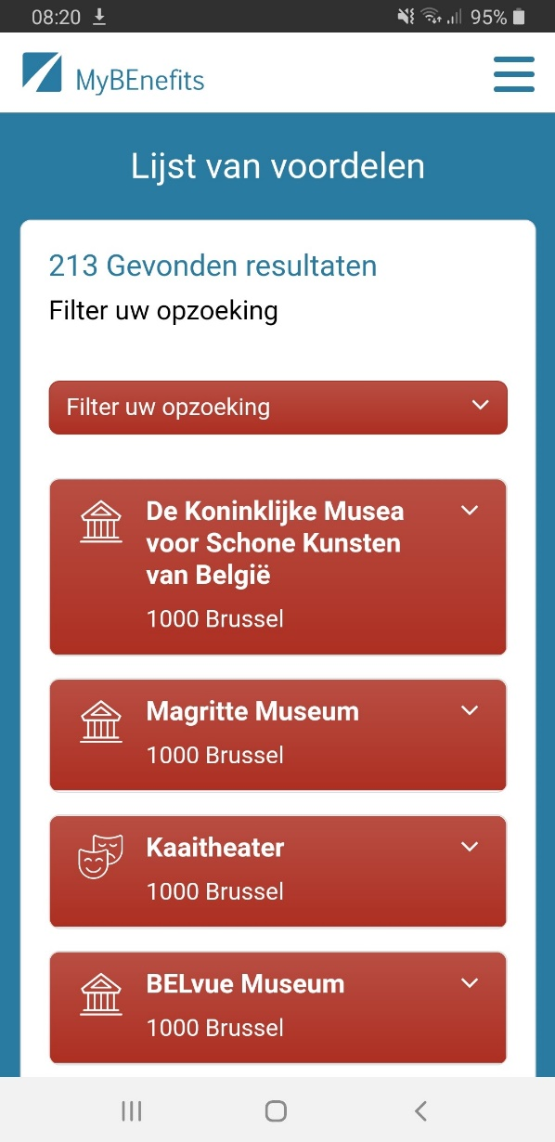
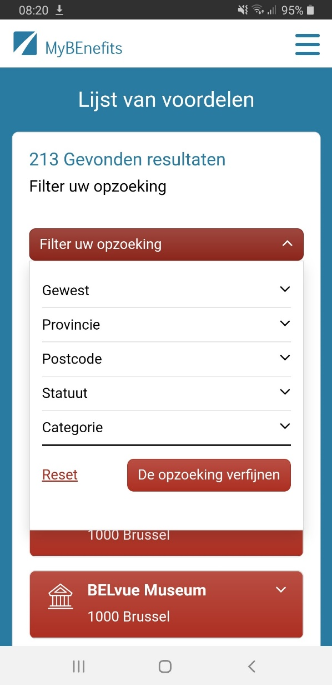
Asking for the social benefits
consulting
the benefits
filtering of
the benefits

Slide 79
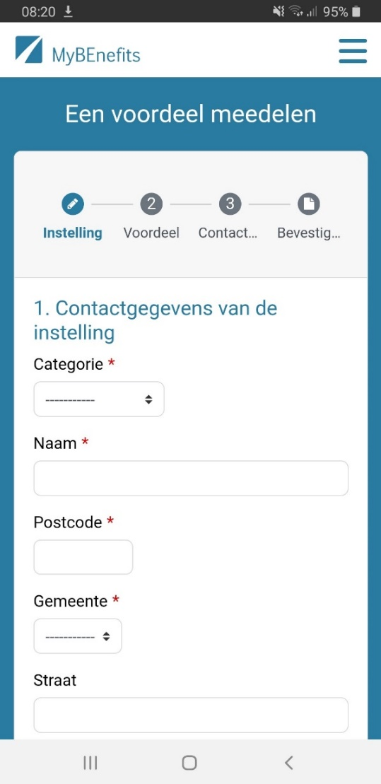
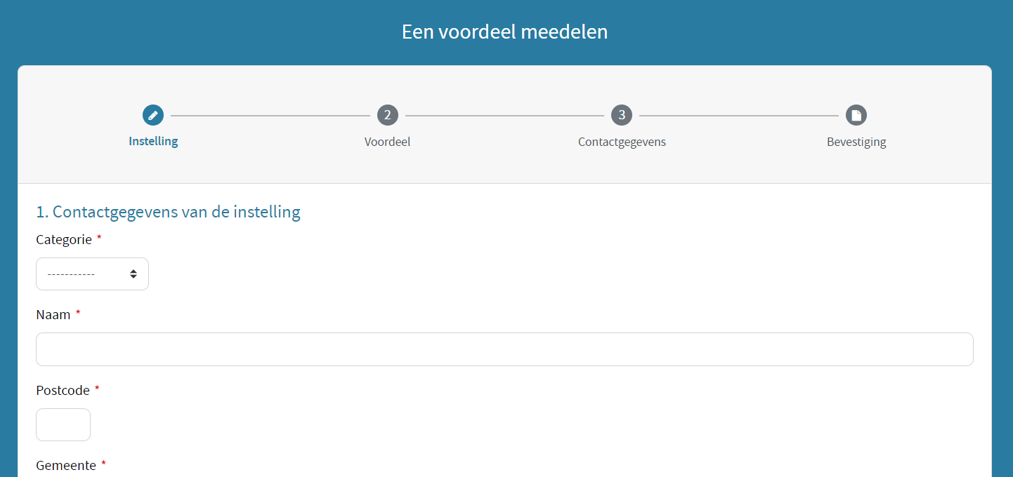
Increasing the visibility and use of social benefits
web app
mobile version

Slide 80
eBox citizen
electronic mailbox in which citizens can receive official documents on an integrated way
the tool is so designed that citizens log in once (single sign on) and can then access the documents intended for them, wherever these documents are stored, via the interface of their choice
electronic transactions via web applications or apps
architecture and technology identical to those of the eBox for companies
the CBSS acts as a Document Provider for 35 bodies (within the fields of social security and health)

Slide 81
eBox citizen
figures eBox citizen on 31/12/2023
  169 439 392 documents published through the CBSS
  5 315 431 digital consents ~= activated electronic mailboxes
  3 425 358 unique activations = 33% of the target population (9 265 289 Belgians citizens aged over 18)
eBox law amended in 2023 including
  legal anchoring of answer citizen or company in eBox message
  mandatory use of eBox by businesses at the latest on 1 January 2025
  mandatory use of eBox as a communication channel depending on volumetry
  additional measures to increase the reading of messages in eBox
development to ensure that an eBox message with a request to access a content in another system contains a link allowing direct access to that content in the other system, if possible without having to log in again (through single sign on (SSO))

Slide 82
Regionalisation
further operational integration into the CBSS network of regional bodies
preparation and activation of data flows at regional bodies
permanent follow-up of the transfer of competences with impact on data flows and services
projects 2024 for the Brussels Region
  electronic access to the pension register (Federal Pension Service (FPD)) for Hydralis/Vivaqua and the City of Brussels
  extension of the communication of social personal data of (potential) tenants and buyers of social houses and the socialisation of rents (Brussels Regional Housing Company and Public Real Estate Companies)
  end-to-end tests of data exchanges with the NSSO (Dimona, Dmfa and social debts)

Slide 83
Regionalisation
projects 2024 concerning Flanders
  start of the central registration register (CIR) of applicants for social housing (Wonen in Vlaanderen)
  calculation of Flemish job bonus for contractual education personnel (DWSE)
  granting of additional benefits for disabled persons to Flemish civil servants by the social service vzw (Agentschap Overheidspersoneel (AgO))
  automatic granting of reduced subscription rate for part-time art education in Flanders (Agentschap voor Onderwijsdiensten (AgODI))
  unaccompanied foreign minors in the context of the Flemish growth package (Opgroeien regie)
  …
projects 2024 concerning Wallonia
  connection via the BCED to various services/data such as pension data, unemployment, career, occupational diseases, career break
  connection of partners to the services already opened by the BCED

Slide 84
PSWC
PSWC online
  electronic request for support from a PCSW is now possible instead of physical request
  low-threshold and reduces non-take-up of rights
  application form will be made available on the social security portal with pre-completion after authentication of the identity
  integration in software packages of PCSWs for processing applications
  use of eBox for communication with requester
PrimaVera
  use of intelligent calculation tool to simulate the right to an integration income and his amount depending on the resources of the requester
access to the services of the PCSW for welfare associations

Slide 85
Combating fraud
active participation to the College for Combating Tax and Social Fraud
> 120 structured data flows developed that enable data matching or data mining, e.g. detection of cumulation of unemployment allowances with wages or cumulation of sickness allowances with pensions
forwarding into the network of an indicator that a BIS number has been created on the basis of fraudulent documents
  cooperation Sigedis - police services
  avoids unjustified granting of rights at social security bodies
  avoids duplication of identity fraud investigations
further development of ePV - eDossier - Dolsis - My Digital Assistant (MyDIA)

Slide 86
Combating fraud
Dolsis
  access to multiple data sources through a unique web interface
  initially developed for traditional inspection services and now used by more than 90 bodies
MyDIA
  for improving cooperation between the inspection services in the fight against social fraud
  mobile application for the inspection services of the NSSO, NEO, FPS ELSD, NIHDI and NISSE to consult identification data from various data sources
Single Permit
  temporary employment in Belgium of non-EU citizens
  residence permit (federal competence) and work permit (regional competence)
  the Single Permit platform hides this complexity for the user (Belgian and foreign employer) at the time of request
  use of the belgianIDpro application that appeals to the services of the CBSS registers to correctly identify the foreign worker

Slide 87
isi+ card
system for
  the secure online real-time consultation via MyCareNet of administrative data managed by insurance agencies
  the identification of the social insured persons using the SSIN available on the electronic identity cards and on the residuary isi+ card
the isi+ card is issued gradually
  to the persons who can not have an electronic identity card but who have social coverage to receive health care in Belgium, in particular
    to cross-border workers living abroad and working in Belgium
    to pensioners with a foreign nationality who moved abroad after working in Belgium and contributing to the Belgian social security system
  to all children < 12 years old
> 2.8 million isi+ cards were created (of which 148 230 in 2023)

Slide 88

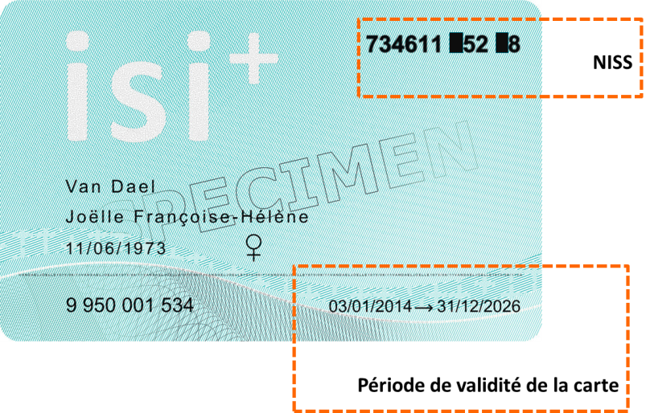
isi+ card today
physical card (polycarbonate) that is difficult to replicate
valid for 12 years
created at birth in most cases
Barcode
Bevat de
volgende
gegevens:
SSIN
kaartnr.
Datamatrix
naam
voornaam
INSZ
geboortedatum
geslacht
geldigheidsdata
kaartnr.

Slide 89
isi+ card through the wallet
visualisation by citizens of their children's isi+ card
on the basis of the data consulted
  at the NR (service ‘affiliation’)
  at the CBSS (DB of the isi+ cards)
main advantage: both parents have access to it

Slide 90
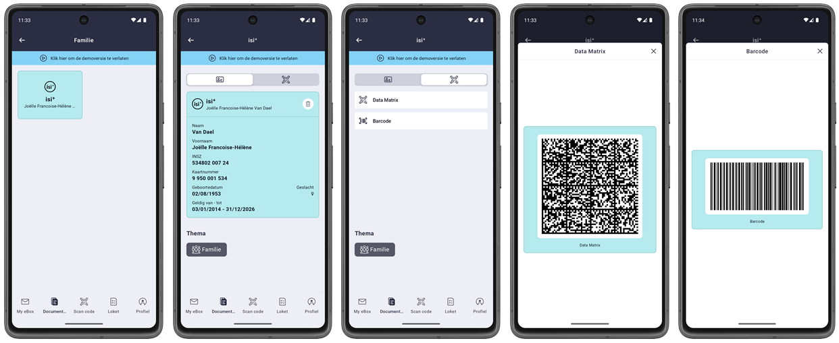
isi+ card through the wallet

Slide 91

G-Cloud
https://www.gcloud.belgium.be/fr/index.html

Slide 92
G-Cloud - Synergies
Business applications
Core business (declarations, business processes, …)
Standard applications & components
Website | Access management | Translation software| …
Sharing
Application platforms
Open Source | IBM | Microsoft| Oracle | SAS | …
Sharing
Soft infrastructure
Virtualisation | Security | Mail | VoIP | …
Sharing
Hard infrastructure
Data centers | Computing | Network | Storage
Sharing

Slide 93
G-Cloud - Synergies
evolution from middlewares and infrastructure management to configuration and exploitation of G-Cloud services with the teams of Smals
Federal Service Platform / API Gateway
  common follow-up agency of the clients: eHealth - CBSS - NOSS
  analysis of common requests, release content and planning, follow-up of incidents and contact with suppliers
  budget follow-up and information on new potential members of the platform
negotiations with suppliers & federal master agreements

Slide 94
G-Cloud advantages
scale effects
  higher efficiency
  higher quality
  higher availability
  reduced cost (infrastructure, software licences, supervision, ...)
respect for confidentiality and data protection
more focus on business and flexibility to achieve goals
more pressure on suppliers
pooling of knowledge and resources
technological evolution available sooner to everyone

Slide 95







Types of cloud implementations
Public Cloud
Shared
Hybrid
Access/Control
Outsourced Community Cloud (= off-premise)
Community Cloud on-premise
Private Cloud on-premise
Outsourced Private Cloud (= off-premise)
Dedicated
Location
Customer
Service Provider

Slide 96
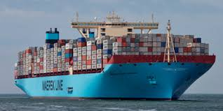
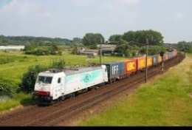
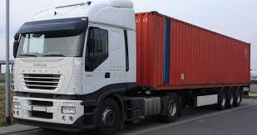
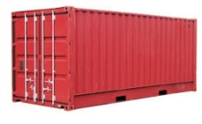






G-Cloud - Platform as a Service (PaaS)
introduction of container technology
transformed into modern technology such as Platform-as-a-Service
individual content
separate registration
and easy transportable
Monitoring
Protection
logging
Coming
soon

Slide 97
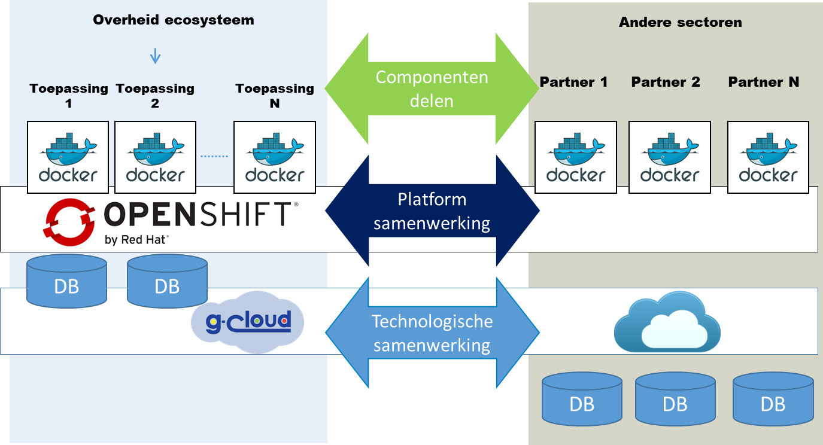
G-Cloud - PaaS - Types of collaboration

Slide 98





G-Cloud - Platform as a Service
Requirements
Release planning
Development &
Release preparation
Release execution
Incident management
1st line
DB
- unit
2nd line
3th line

Slide 99
G-Cloud - Paas - reference directory
Requirements
Release planning
Development &
Release preparation
Release execution
Users / partners
DB
FPS BOSA
DTO
FOD’s
Justice
Mobility
…

Slide 100
Status G-Cloud service portfolio (26/11/2021)

Slide 101
Datawarehouse labor market
created to respond effectively to data requests from research centres and public authorities
initially created on the basis of data from social security institutions, the national register and the Bis register and completed using self-defined concepts
put into production at the beginning of 2001
over the years increase of the number of bodies providing data
  relevant data from all actors in the social sector
  relevant data from other actors (e.g. FPS Finances, ADSEI, ...)
  each time after deliberation of the information security committee (ISC)

Slide 102
Datawarehouse labor market
support to bodies in charge of policy preparation and evaluation and researchers in accessing the data warehouse for their ad hoc needs
adoption of a standard methodology for codification and anonymisation of data
enlargement of the basic statistics, i.e. frequently requested statistics that are automatically created and distributed, and their consultation by using 5 web applications
  online statistics/local figures
  online statistics/global figures
  online statistics/socio-economic mobility
  online statistics/family composition
  online statistics/socio-economic mobility on the short-term
no content management of the data by the CBSS

Slide 103
Services for employers
> 50 electronic services for businesses, in the form of the exchange of electronic messages from application to application, as well as in the form of 40 interconnected portal transactions
declarations will be limited to 3 moments
  the immediate declaration of employment and dismissal (DIMONA)
  the quarterly declaration of wage and working time data (DmfA)
  the occurrence of a social risk (DSR)
> 45 million electronic declarations by employers in 2023

Slide 104
Dimona
immediate declaration of entry and exit of an employee by the employer
only electronically, 24/24 and 7/7 via
  the social security portal
  FTP/MQSeries
  Isabel network
  vocal server
  mobile phone
  Google Assistant (in test)
at reception of this declaration, the employee's identity is verified so that all actors in the social sector would use a correct and uniform identification key of the employee

Slide 105
DmfA
electronic declaration by the employer of his employees' wage and working time data
with multifunctional status (harmonised concepts)
the declared data are available electronically over the social security network to all social sector actors who need them to carry out their missions
this declaration can be consulted and corrected online later by the employer by means of an electronic certificate for his employees and the period in which he employed them

Slide 106
DSR
data collection is limited to the information not yet available in the social security network (abolition or at least simplification of forms)
is standardised for the sectors involved in the declaration of social risk (disability, maternity, accident at work, occupational disease, unemployment)
the declaration can be made
  electronically (24/24 et 7/7) through
    the social security portal
    FTP/MQSeries
    the Isabel network
  on paper for some scenarios (temporarily)
according to unambiguous instructions

Slide 107
Services for citizens
as far as possible, citizens obtain their rights automatically by means of electronic service delivery between social sector actors
for the rights that can not be provided automatically, integrated electronic services are progressively offered through the portals of the social sector actors
29 services are operational through an integrated portal and/or mobile applications

Slide 108
Services for third parties - examples
transaction for building owners on the social security portal
  electronic consultation of the fact that an employer is in order with its social security obligations and verification of the existence or non-existence of a several liability or a withholding obligation
transactions for municipalities on the social security portal
  My Handicap and Handiweb: electronic submission of an application for disability benefits to the FPS Social Security
  E-Creabis: online consultation and, if necessary, creation of the unique social security identification number in the National Register or the CBSS registers
  electronic submission of a pension application (FPS)
  submission of a will regarding euthanasia

Slide 109
Services for third parties - examples
transaction for bailiffs
  fourth way - social notification: public or ministerial officials are enabled to transmit their notifications and information by electronic means
My Handicap
  the competent persons for persons with disabilities can submit a request for a citizen and consult the file of a person with disabilities
Limosa
  multifunctional and unique declaration of all activities of foreign workers, self-employed persons or trainees on Belgian territory

Slide 110
Social security portal
access point to all social security information and online services
1 international component + 3 target groups
  citizens
  companies (employers, self-employed, mandate holders, social service providers, trustees, companies working with contractors, etc.)
  civil servants and other social security professionals
the portal provides an overview of the aims of each online service and the level of security required to access it
the CBSS is playing the role of driving force in its development and ensuring the coordination of the informational component

Slide 111
7. Conclusion

Slide 112
Achieved benefits
increased efficiency
  reduced burdens and costs, e.g.
    one-time collection of information using harmonised concepts and instructions
    as much as possible electronic exchange of data from application to application, without manual re-entry
    distribution of tasks concerning information management and validation
    fewer unnecessary contacts afterwards
    cooperation on application development (assembly engineering) through availability of reusable services and components
  more services for the same total cost, e.g.
    all services available at any time, from any place and via any device
    integrated services
  faster service delivery
    reduction of travel and waiting time
    direct interaction with the competent service
    real time feedback for the user

Slide 113
Achieved benefits
effectiveness gains
  better quality of service delivery, e.g.
    more accurate services
    more personalised services
    more transparent services
    more secure service delivery with better protection of privacy
    possibility for the user to perform quality control of the service delivery process, e.g. through the possibility of electronic consultation of the status of the service delivery process
  less fraud possibilities
  new types of services, e.g.
    as far as possible automatic granting of rights
    automatic information on possible rights, which cannot be granted automatically
    active search for non-take-up of some rights via data warehousing techniques
    direct control on own data
    personalized simulation environments

Slide 114
Critical success factors
focus on added value
balance stability – change
cooperation with confidence
chain
process
optimisation
active search for synergies
agile development and training
compliance with basic principles
focus on
key tasks
solid ICT architecture
GDPR

Slide 115
More information
website CBSS
https://www.ksz-bcss.fgov.be
website MyBEnefits
→ https://mybenefits.fgov.be
website Datawarehouse arbeidsmarkt en sociale bescherming
→ https://www.ksz-bcss.fgov.be/fr/dwh/homepage
social security portal
→ https://www.socialsecurity.be

Slide 116
Abbreviations
APA - allowance for assistance to the elderly
ARR - income replacement allowance
DUNIA - déclaration uniforme – uniforme aangifte
GDPR – General data protection regulation
GEB - gegevensbeschermingseffectbeoordeling
GGC - Gemeenschappelijke Gemeenschapscommissie
isi+ - social identification
ISC – information security committee
IT - integratietegemoetkoming
PISS – public institution for social security
ORINT - Interregionaal Orgaan voor de Gezinsbijslag
VAZG - Vlaams agentschap Zorg en Gezondheid
VGC - Vlaamse Gemeenschapscommissie
VLABEL - Vlaamse Belastingdienst
VLAIO - agentschap Innoveren & Ondernemen
VSB - Vlaamse sociale bescherming
VUTG - Vlaams agentschap Uitbetaling Groeipakket
ZBO - zorgbudget voor ouderen met zorgnood

Slide 117
Thanks for your questions

